Slide 1
Image Formation

Slide 2
Objectives
Fundamental imaging notions
Physical basis for image formation
Light
Color
Perception
Synthetic camera model
Other models

Slide 3
Image Formation
In computer graphics, we form images which are generally two dimensional using a process analogous to how images are formed by physical imaging systems
Cameras
Microscopes
Telescopes
Human visual system

Slide 4
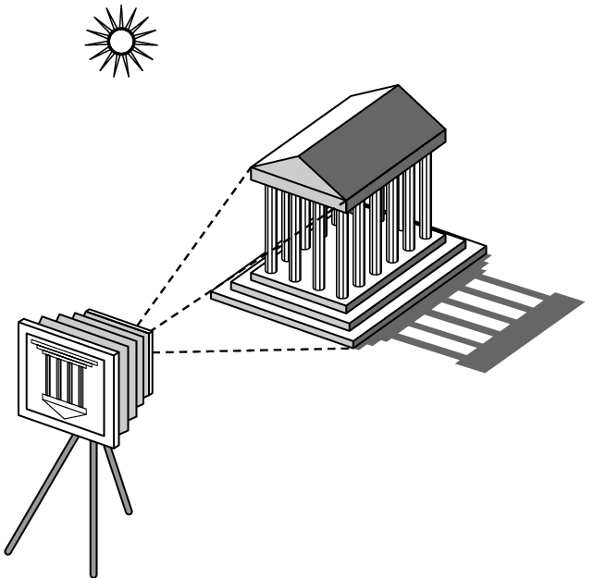
Elements of Image Formation
Objects
Viewer
Light source(s)
Attributes that govern how light interacts with the materials in the scene
Note the independence of the objects, the viewer, and the light source(s)

Slide 5
Light
Light is the part of the electromagnetic spectrum that causes a reaction in our visual systems
Generally these are wavelengths in the range of about 350-750 nm (nanometers)
Long wavelengths appear as reds and short wavelengths as blues

Slide 6
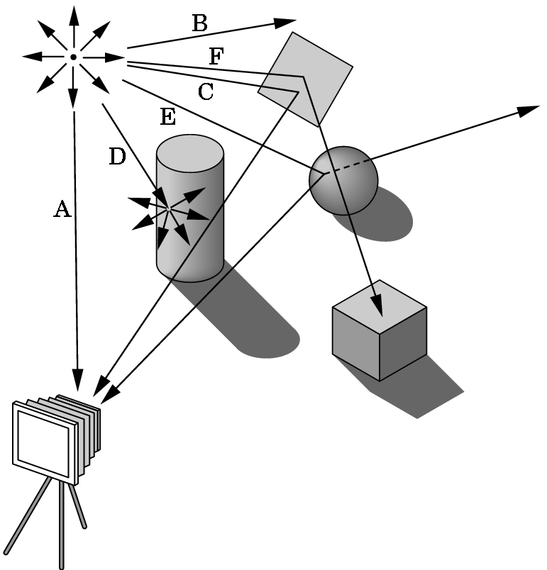
Image Formation
One way to form an image is to
follow rays of light from a
point source finding which
rays enter the lens of the
camera. However, each
ray of light may have
multiple interactions with objects
before being absorbed or going to infinity.

Slide 7
Luminance and Color Images
Luminance Image
Monochromatic
Values are gray levels
Analogous to working with black and white film or television
Color Image
Has perceptional attributes of hue, saturation, and lightness
Do we have to match every frequency in visible spectrum? No!

Slide 8
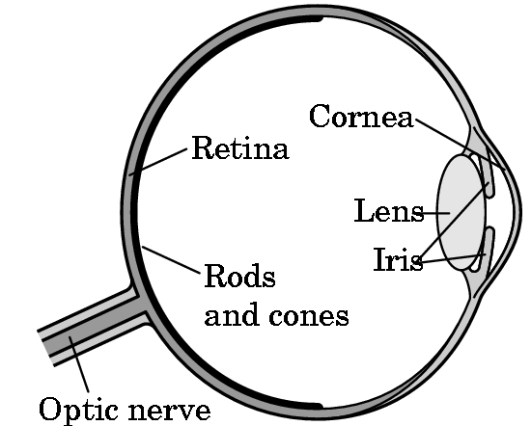
Three-Color Theory
Human visual system has two types of sensors
Rods: monochromatic, night vision
Cones
Color sensitive
Three types of cones
Tristimulus values sent to the brain
Need only match these three values
Need only three primary colors

Slide 9
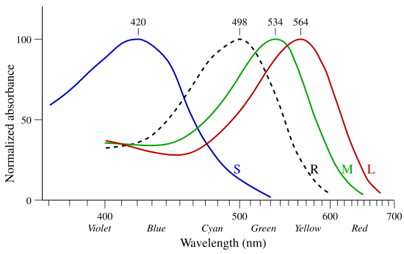
Tristimulus Response
Normalized response spectra of human cones to monochromatic spectral stimuli
Angel: Interactive Computer Graphics5E © Addison-Wesley 2009
9

Slide 10
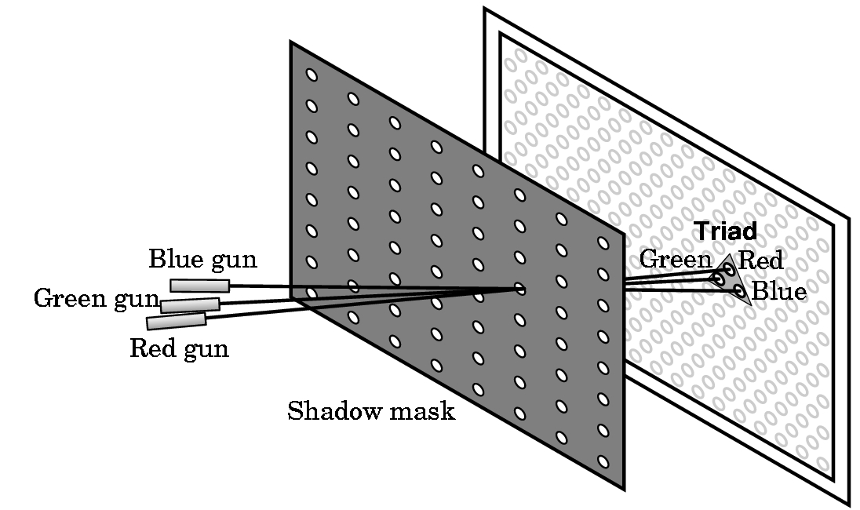
Shadow Mask CRT

Slide 11
Additive and Subtractive Color
Additive color
Form a color by adding amounts of three primaries
CRTs, projection systems, positive film
Primaries are Red (R), Green (G), Blue (B)
Subtractive color
Form a color by filtering white light with cyan (C), Magenta (M), and Yellow (Y) filters
Light-material interactions
Printing
Negative film

Slide 12
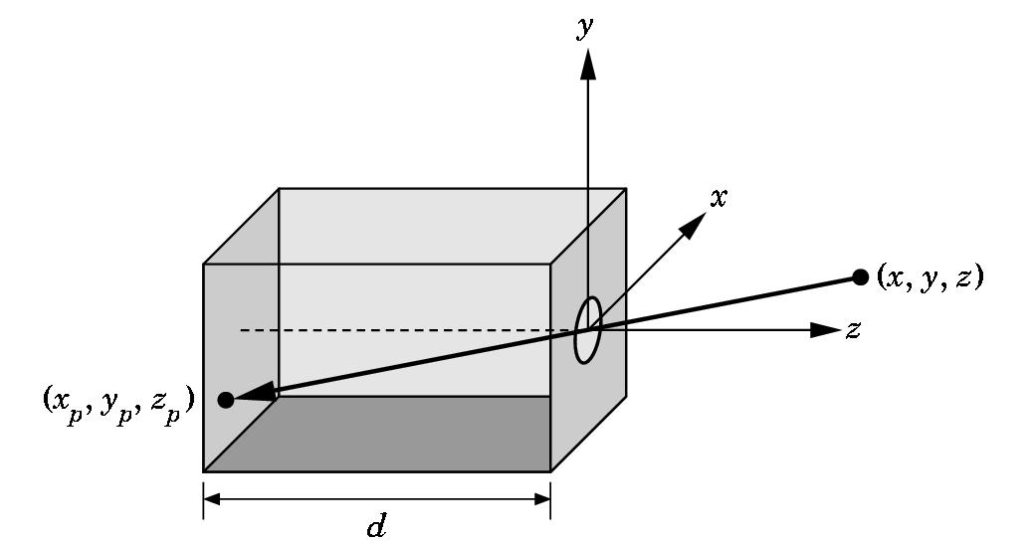
Pinhole Camera
Assume we have a pinhole camera with “lens” located at location (0,0,0) and pointing down the Z-axis
Light will pass through the pinhole lens and an image will be formed on the Z=d plane

Slide 13
Pinhole Camera
Use geometry to calculate where point (x,y,z) will appear at location (x_{p}, y_{p}, z_{p}) on the image plane
x_{p}= -xd/z
y_{p}= -yd/z
z_{p}= d
These are the equations for perspective projection

Slide 14
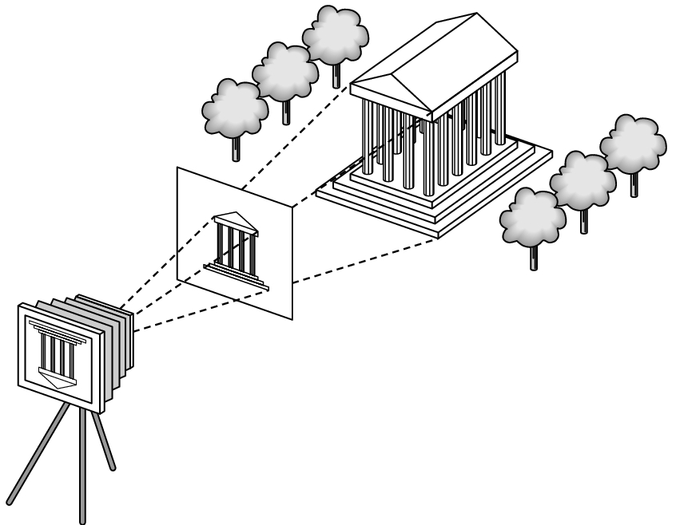
Synthetic Camera Model
projector
p
image plane
projection of p
center of projection

Slide 15
Advantages
Separation of objects, viewer, light sources
Two-dimensional graphics is a special case of three-dimensional graphics
Leads to simple software API
Specify objects, lights, camera, attributes
Let implementation determine image
Leads to fast hardware implementation

Slide 16
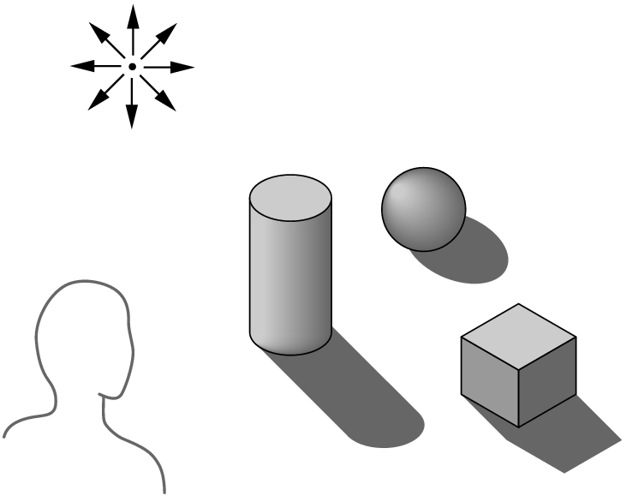
Global vs Local Lighting
Cannot compute color or shade of each object independently
Some objects are blocked from light
Light can reflect from object to object
Some objects might be translucent

Slide 17
Why not ray tracing?
Ray tracing seems more physically based so why don’t we use it to design a graphics system?
Possible and is actually simple for simple objects such as polygons and quadrics with simple point sources
In principle, can produce global lighting effects such as shadows and multiple reflections but ray tracing is slow and not well-suited for interactive applications

